Slide 1

Sylvia’s Monster Minder
A Fables of Sylvius^{©TM} Combat Encounter Manager
Victor Aw
Rose Nish
Marissa Melen

Slide 2
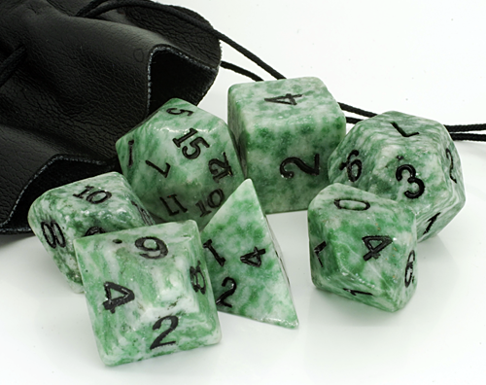
Fables of Sylvius:
Table top RPG
Attacks go through opponent stats
Weapons, player damage
Status effects
Many monsters needed for encounters
Multiple encounters per meeting
Time consuming and tedious

Slide 3
Program Requirements:
Generate random encounters
Generate multiple encounters
Create monsters for encounters
Track monster stats
Track status effects
Allow for editing/custom monsters
Track monster health

Slide 4
